Slide 1
Keras
Deep Learning
Study
발표범위 : 5-1 ~ 5-2

Slide 2
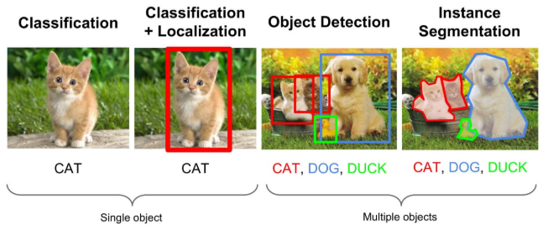
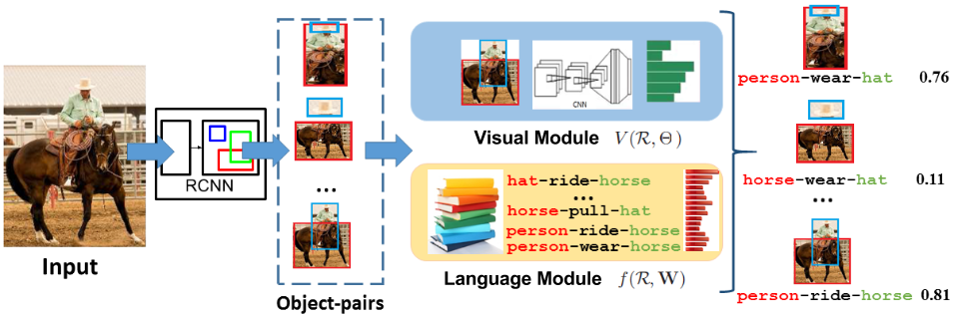
컴퓨터 비전에서의 문제
1. Classification
2. Object Detection
3. Image Segmentation
4. Visual relationship
https://ganghee-lee.tistory.com/35
https://cs.stanford.edu/people/ranjaykrishna/vrd/

Slide 3
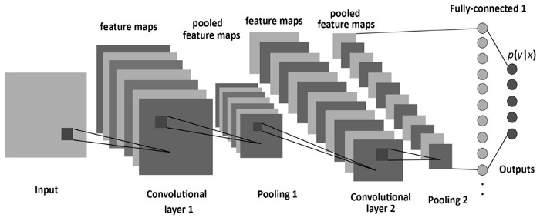
5-1 합성곱 신경망 소개
Conv2D, MaxPooling2D 의 출력은 (height, width, channels) 의 3D 텐서
https://hobinjeong.medium.com/cnn%EC%97%90%EC%84%9C-pooling%EC%9D%B4%EB%9E%80-c4e01aa83c83

Slide 4
https://cs231n.github.io/convolutional-networks/

Slide 5
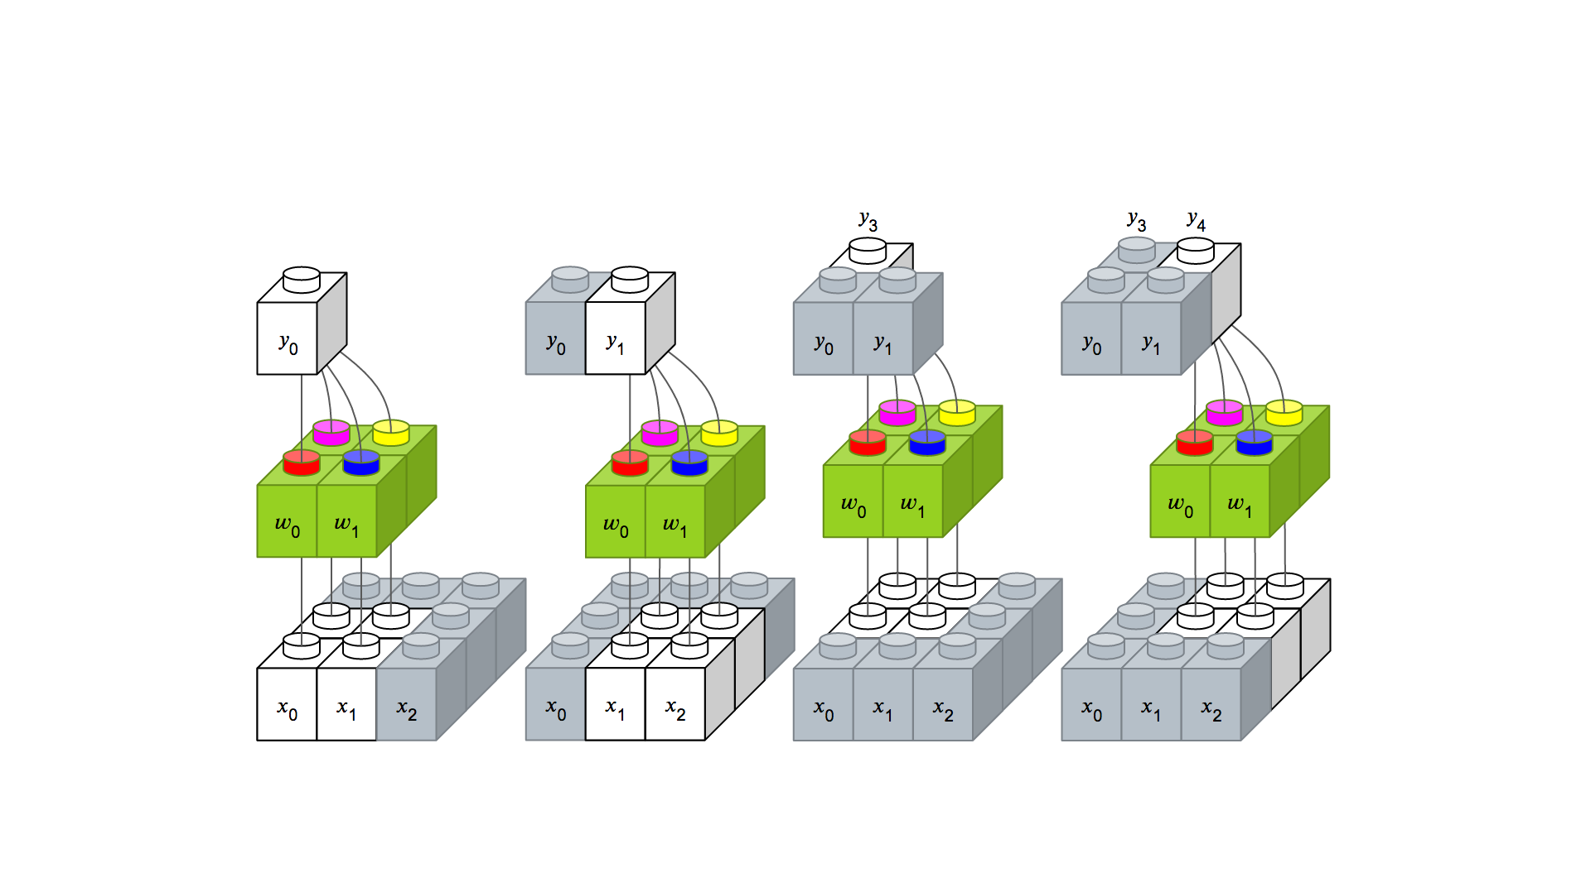
Filter
https://tykimos.github.io/2017/01/27/CNN_Layer_Talk/

Slide 6
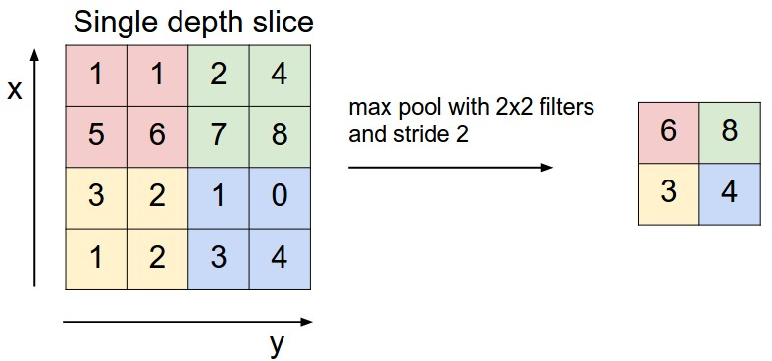
Max Pooling
https://cs231n.github.io/convolutional-networks/

Slide 7
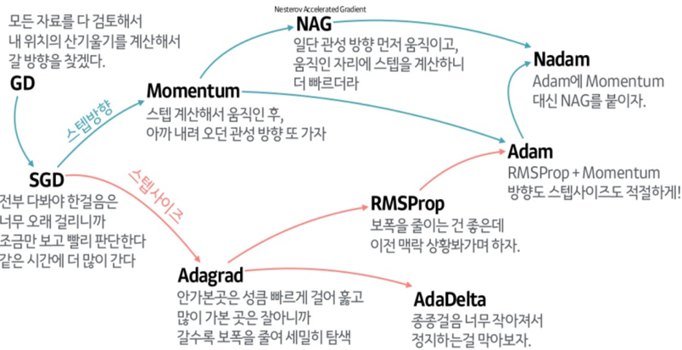
Optimizer
https://onevision.tistory.com/entry/Optimizer-%EC%9D%98-%EC%A2%85%EB%A5%98%EC%99%80-%ED%8A%B9%EC%84%B1-Momentum-RMSProp-Adam

Slide 8
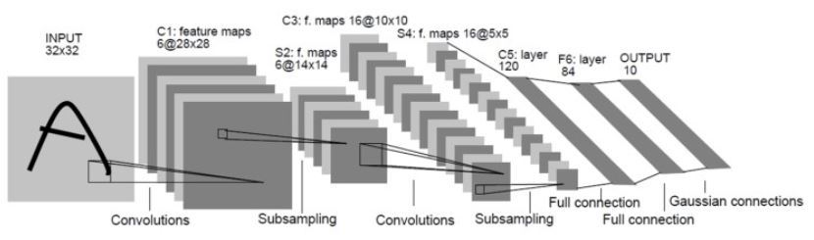
LeNet-5
https://bskyvision.com/418

Slide 9
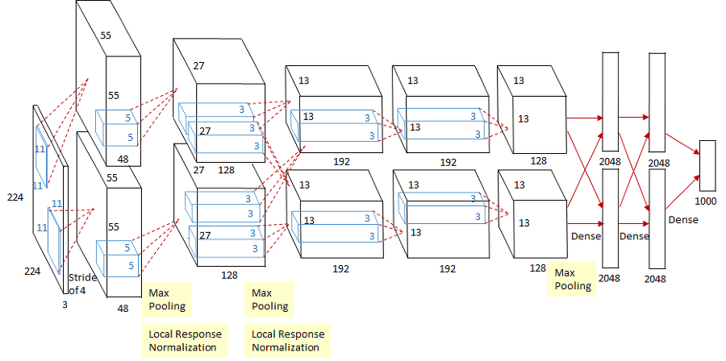
AlexNet
https://bskyvision.com/421

Slide 10
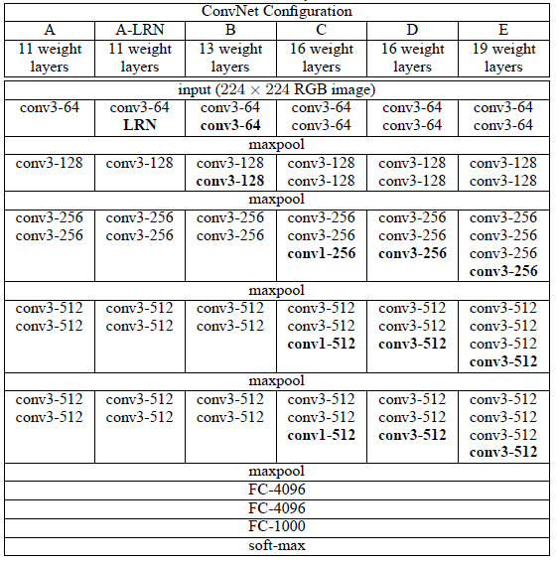
VGG A, A-LRN, B, C, D, E
https://bskyvision.com/504

Slide 11
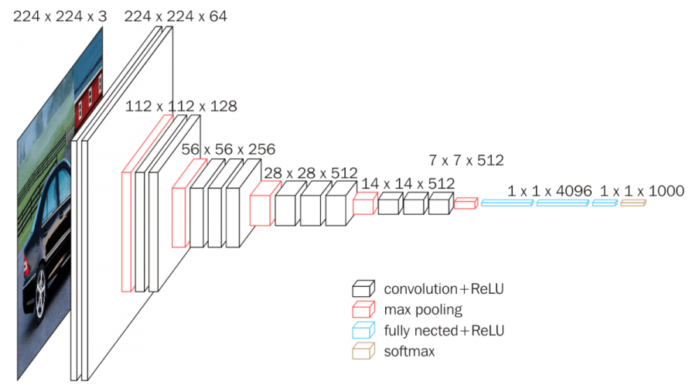
VGG D(16)
https://bskyvision.com/504

Slide 12
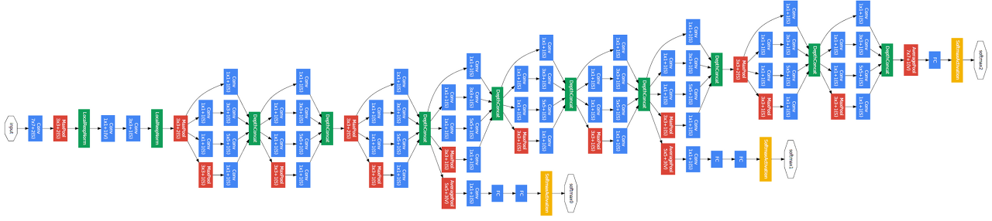
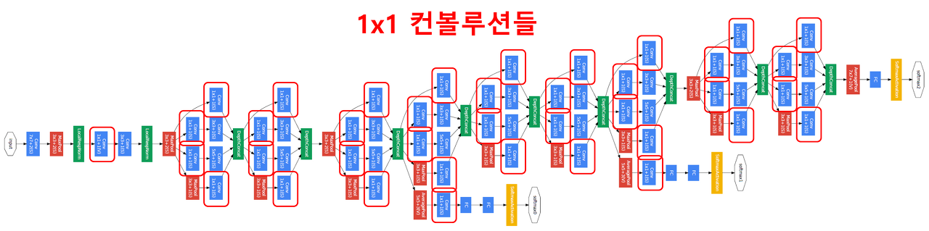
GoogLeNet - Inception v1
https://bskyvision.com/539

Slide 13
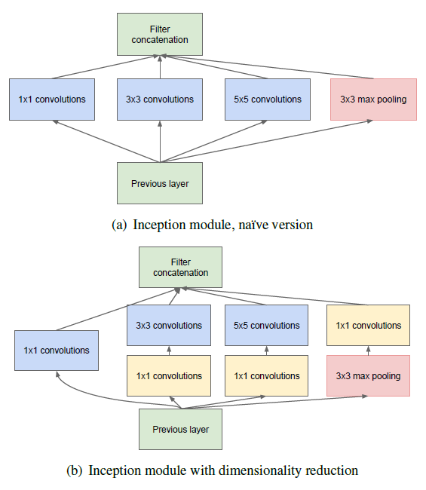
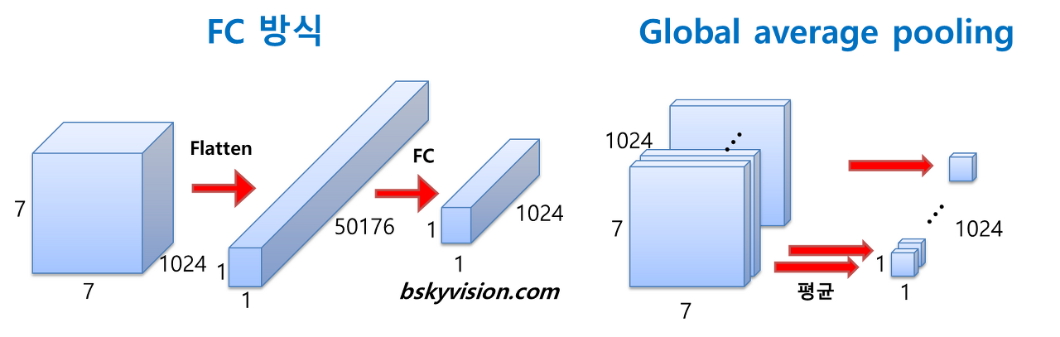
GoogLeNet - Inception v1
https://bskyvision.com/539

Slide 14
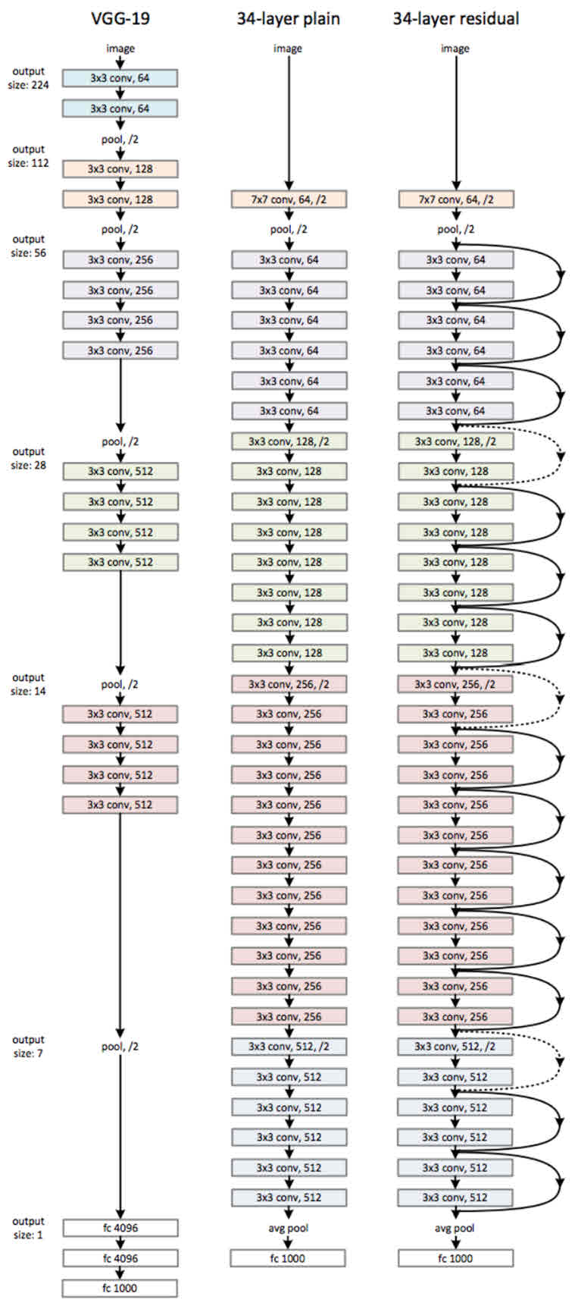
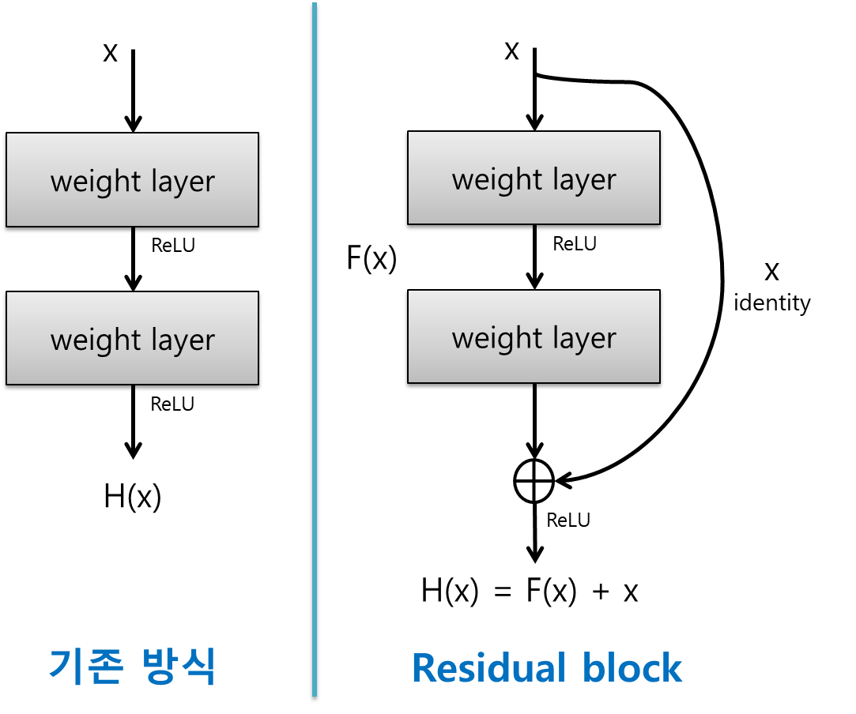
ResNet
https://bskyvision.com/644

Slide 15
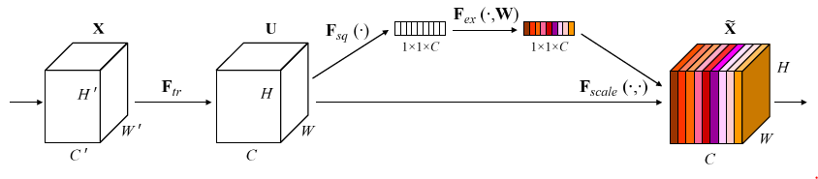
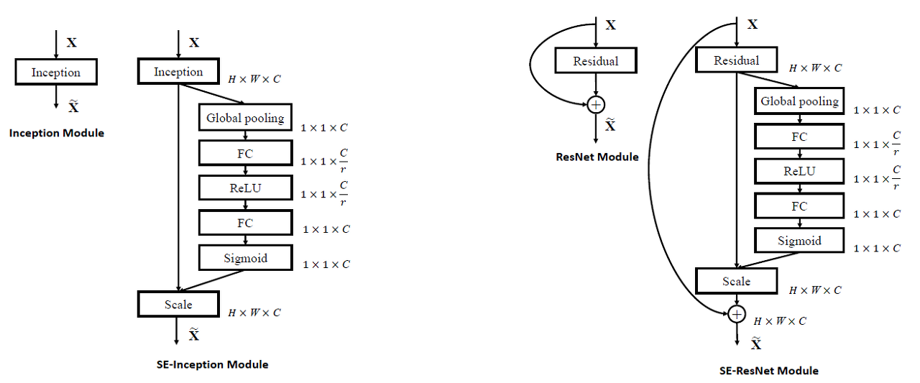
SENet
https://bskyvision.com/640

Slide 16
기업 라이브러리
아마존 레코그니션(Amazon Rekognition)
구글 클라우드 비전 API(Google Cloud Vision API)
마이크로소프트 컴퓨터 비전 API(Microsoft Computer Vision API)
애저 페이스 API(Azure Face API)
IBM 왓슨 비주얼 레코그니션(IBM Watson Visual Recognition)
데이터 분석 패키지 매트랩(Matlab)
애플 비전(Apple Vision)
https://www.itworld.co.kr/insight/162635

Slide 17
5-1 합성곱 신경망 소개 실습
5-2 소규모 데이터셋에서 밑바닥부터 컨브넷 훈련하기 실습
https://colab.research.google.com/drive/1aX38SknC5guOQ0SGQwgQ7GafSNFHzxMZ?usp=sharing
https://colab.research.google.com/drive/17_fz6neWeaWm2fFV4OcDxsdVu90Csjpp?usp=sharing

